Slide 1

^{Database Management System}
^{Overview of Databases}

Slide 2

^{Table of content}
^{Overview of Database}
Database Management System (DBMS)
^{DBMS Types}
^{DBMS Architecture}
^{Data Independence}
^{Integrity Constraints}

Slide 3
^{Overview of Database}
A database is a structured collection of data that is organized and stored in a systematic manner to facilitate efficient data management and retrieval.
It is designed to store, manage, and manipulate large volumes of data in a consistent and secure manner.
Databases offer mechanisms for creating, updating, and deleting data.
They provide a set of operations, such as inserting new records, modifying existing records, and deleting unwanted data.
Databases enable efficient querying and retrieval of data.
They support a query language (e.g., SQL) that allows users to specify search criteria and retrieve desired information from the database.

Slide 4
^{Data vs Information}
Data: Data refers to raw facts, figures, or symbols that represent various attributes or characteristics. It consists of unprocessed, unorganized, and unstructured elements.
Data can exist in different forms, such as numbers, text, images, audio, or video. Examples of data include individual measurements, observations, or records of transactions.
Information: Information, on the other hand, is the result of processing and organizing data in a meaningful way to provide context, relevance, and value.
It is data that has been processed, analyzed, and interpreted to generate insights, knowledge, or understanding.
Information is derived from data through the application of various processes, such as sorting, filtering, aggregating, and analyzing.

Slide 5
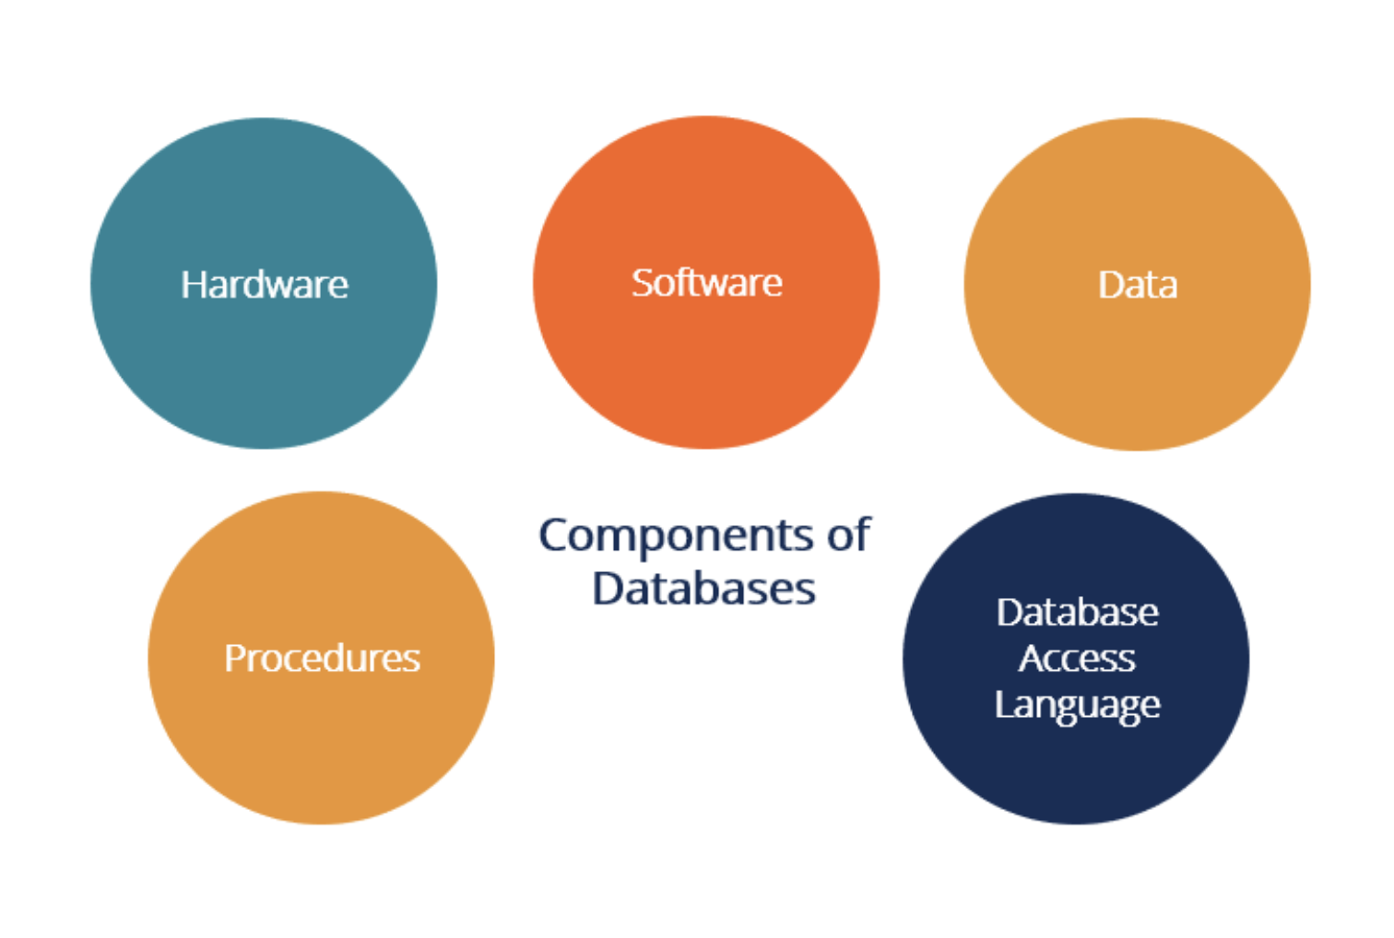
^{Components of Databases}

Slide 6
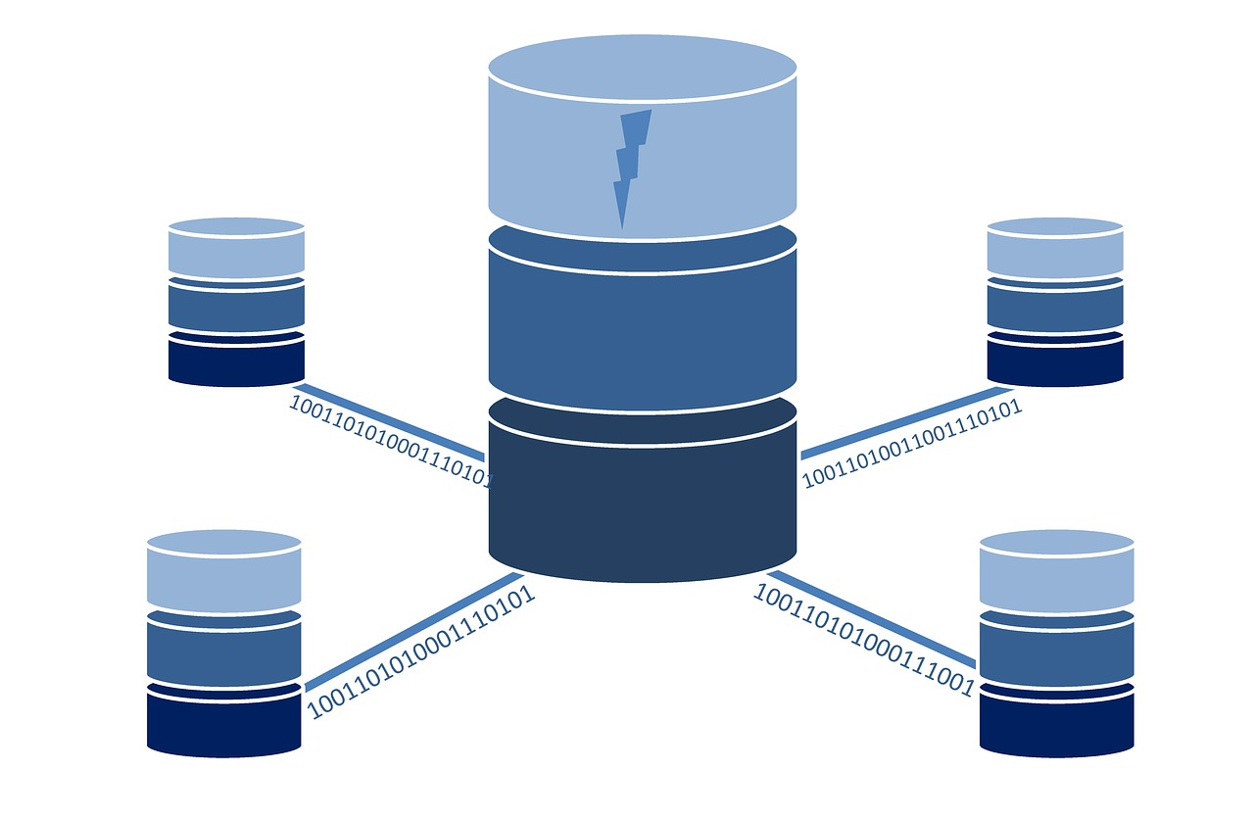
DBMS

Slide 7
Introduction to Database Management System
DBMS stands for Database Management System. The software application allows users to efficiently store, manage, and retrieve data in a structured format.
DBMS serves as an intermediary between the user and the database, providing a convenient way to interact with data.
The primary function of a DBMS is to provide an organized and controlled environment for creating, storing, and manipulating databases.
DBMS are widely used in various domains, including business applications, scientific research, e-commerce, finance, and more.
They provide a scalable, reliable, and efficient way to manage and utilize large volumes of data.

Slide 8
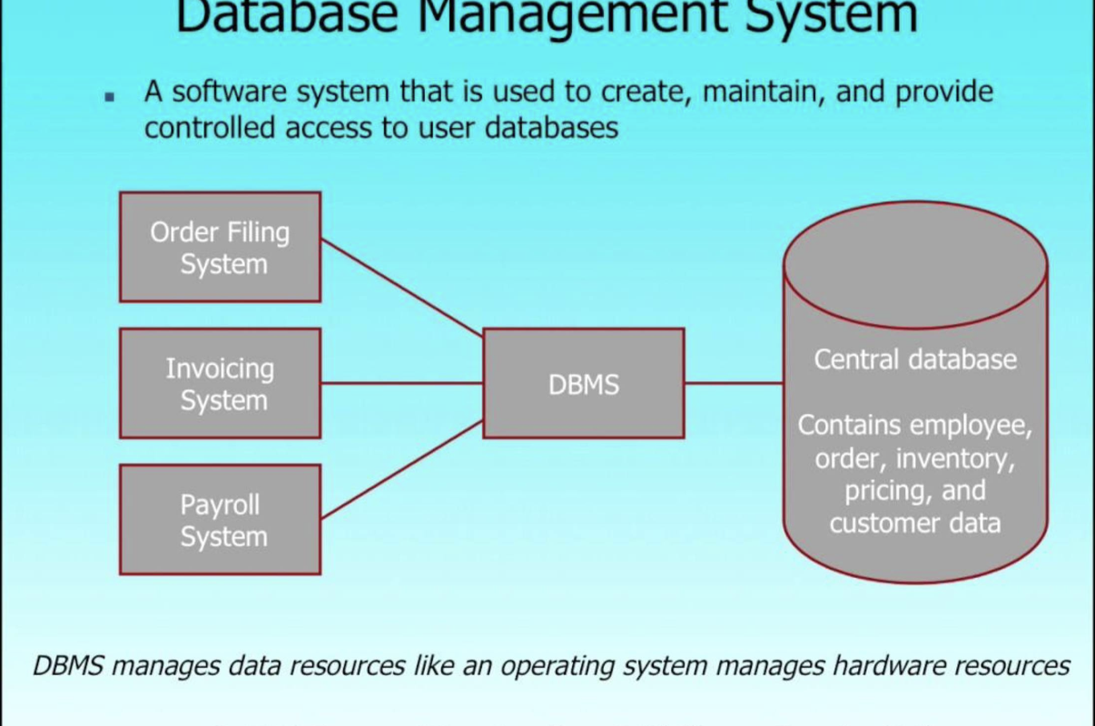
Introduction to Database Management System

Slide 9

^{Why use Database?}
Data Independence and efficient access.
Reduced application development time.
^{Data integrity and security}
^{Uniform data administration}
Concurrent access, recovery from crashes.

Slide 10
^{Database Types}
Centralized and Client-Server Systems
^{Server System Architectures}
^{Parallel Systems}
^{Distributed Systems}
^{Network Types}

Slide 11
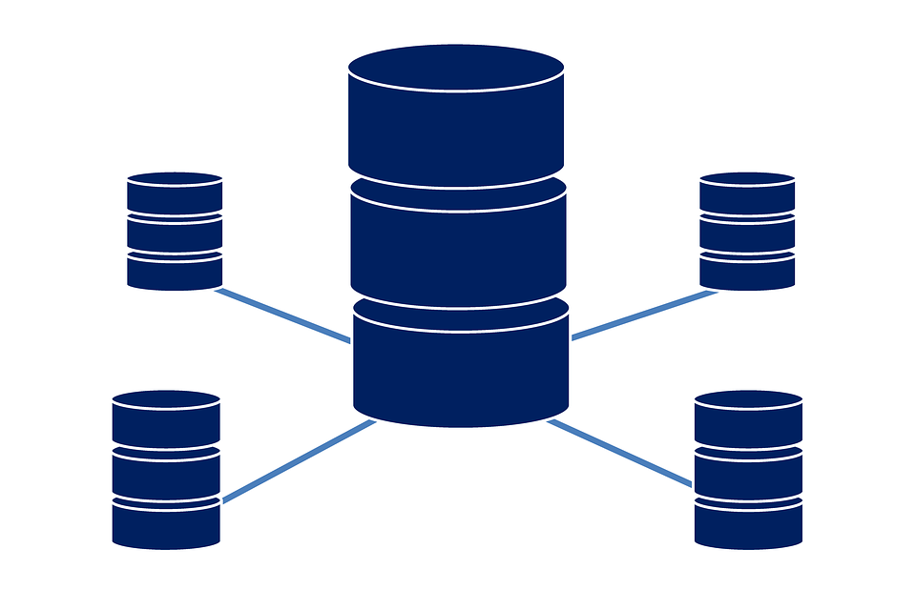
DBMS Types : Centralized Systems
Centralized Data Storage : all data is stored in a single central repository, typically on a dedicated server or a mainframe computer.
Single Point of Control: The central server in a centralized system serves as the central point of control for data management and system administration.
Data Access and Processing: Users or client applications in a centralized system access the data by connecting to the central server.
Centralized systems have been widely used in various domains, including small businesses, early enterprise systems, and legacy architectures. While they offer simplicity and centralized control, they can face challenges related to scalability, fault tolerance, and network dependencies.

Slide 12
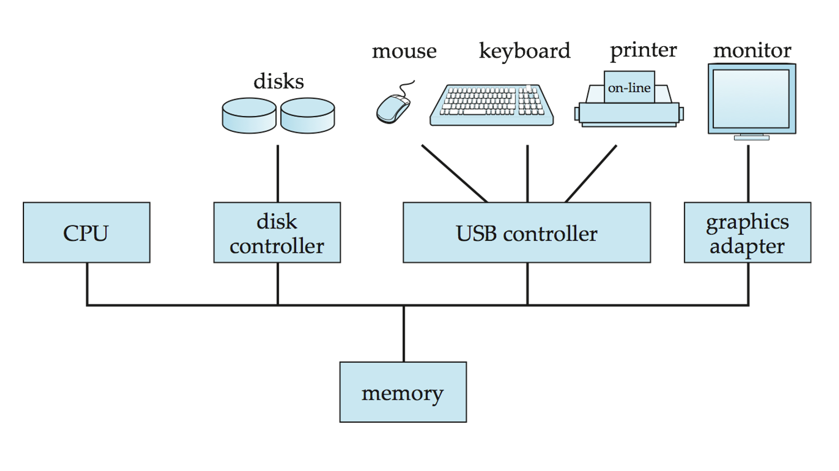
DBMS Types : Centralized Systems

Slide 13
DBMS Types : Client-Server Systems
A client-server system is a distributed computing architecture where computing tasks and resources are divided between two main components: the client and the server.
The client-server model allows for efficient sharing of data, processing power, and services between multiple clients (user interfaces or applications) and a central server.
Client Component: The client component refers to the user interface or application that makes requests to the server for data or services.
Server Component: The server component is responsible for managing and providing the requested services or data.
Communication: Clients and servers communicate with each other over a computer network using standard protocols like TCP/IP.
Resource Sharing: In a client-server system, servers provide shared resources and services to multiple clients.

Slide 14
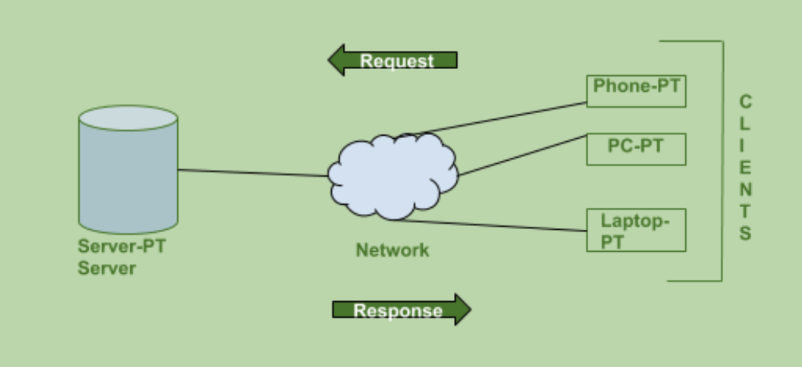
DBMS Types : Client-Server Systems

Slide 15
DBMS Types : Parallel-Server Systems
Parallel-server systems, also known as parallel database systems, are a type of distributed computing architecture designed to improve performance and scalability by dividing data and processing tasks across multiple servers or nodes.
In a parallel-server system, data is partitioned and distributed across multiple servers, and each server operates independently to process its assigned portion of the workload.
Parallel Processing: In a parallel-server system, the workload is divided into smaller tasks that can be processed simultaneously by multiple servers.
Data Partitioning: Data in a parallel-server system is partitioned or divided into smaller subsets, and each partition is assigned to a specific server.

Slide 16
DBMS Types : Distributed Systems
Distributed systems are a type of computing architecture that involves multiple autonomous computers or nodes working together to achieve a common goal.
In a distributed system, these nodes are connected through a network and communicate with each other to share resources, perform computations, and provide services.
Decentralization: In a distributed system, there is no central authority or central server that controls all the nodes.
Resource Sharing: Distributed systems enable the sharing of computing resources such as processing power, memory, storage, and data.

Slide 17
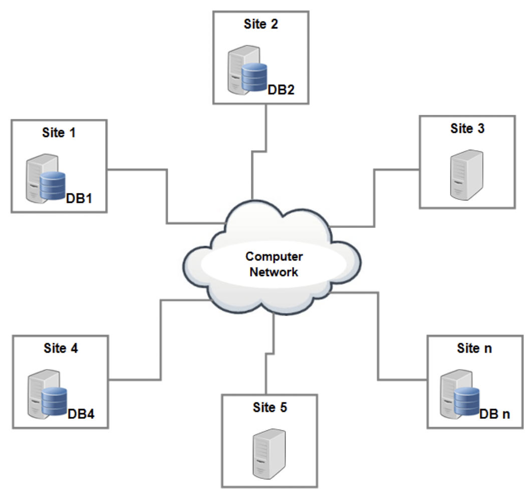
DBMS Types : Distributed Systems

Slide 18
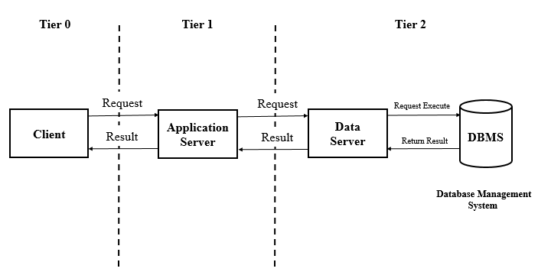
DBMS
Architecture

Slide 19
^{DBMS Architecture}
^{1. One-Tier Architecture:}
The 1-tier database architecture, also known as the standalone architecture or single-tier architecture, is the simplest form of database architecture.
In this architecture, all the components required to run the database reside on a single machine or system. It combines the database management system (DBMS), application logic, and user interface into a single entity.
In a 1-tier database architecture, the database, application code, and user interface are tightly coupled and operate together on a single system.

Slide 20
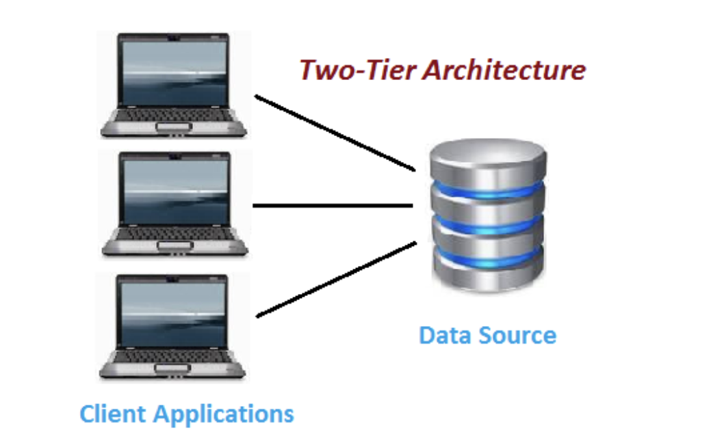
^{DBMS Architecture}
^{2. Two-Tier Architecture:}
Also known as client-server architecture, this model consists of two layers: the client layer and the server layer.
The client layer includes the user interface and application logic responsible for interacting with the database.
The server layer houses the DBMS software and manages the storage and retrieval of data. It handles query processing, transaction management, and data integrity.

Slide 21
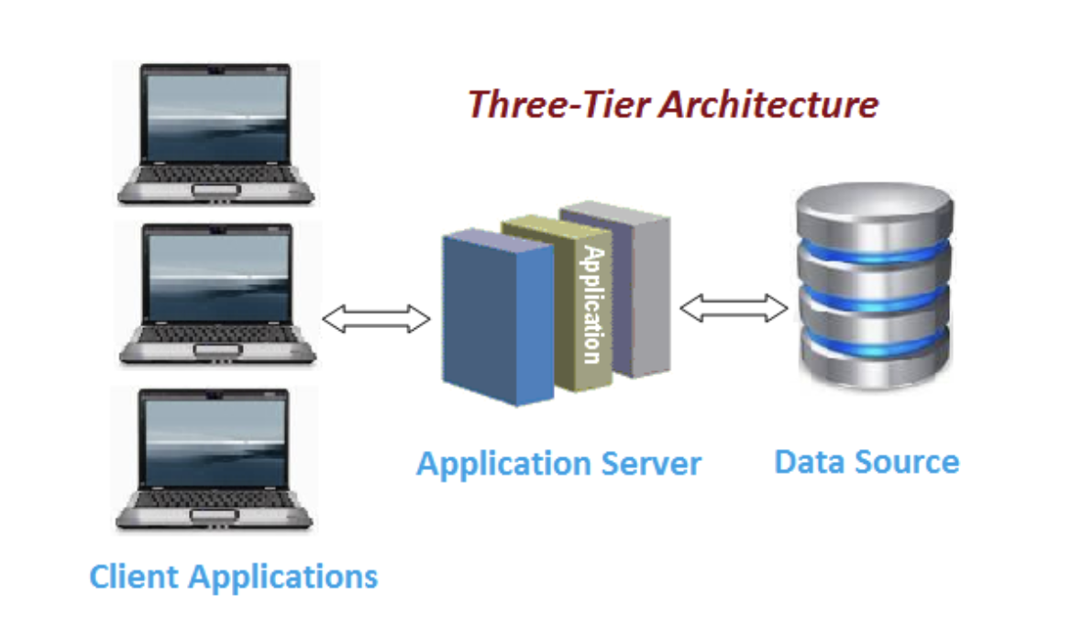
^{DBMS Architecture}
^{3. Three-Tier Architecture:}
This model adds an additional middle tier between the client and server layers, providing better scalability, flexibility, and separation of concerns.
The three tiers are the presentation tier (client interface), application tier (business logic), and data tier (database server).
The presentation tier handles user interaction, the application tier processes business logic, and the data tier manages data storage and retrieval.

Slide 22
^{Data Independence}
Data independence is a concept in database management systems (DBMS) that allows the logical and physical aspects of the database to be separated.
Data independence is achieved through the use of a data abstraction layer provided by the DBMS.
There are two types of data independence:
Logical Data Independence: Logical data independence ensures that the conceptual schema or logical view of the database can be modified without impacting the external schema or user applications.
It allows for changes in the organization, structure, or relationships of the data, such as adding, modifying, or deleting tables, columns, or relationships, without requiring changes to the applications that access the data.

Slide 23
Data Independence : Physical Data Independence
Physical Data Independence: Physical data independence enables changes in the physical storage and access methods of the data without affecting the logical schema or user applications.
It allows for modifications to the physical organization of the data, such as moving or redistributing data across storage devices, changing indexing or partitioning strategies, or altering data storage formats.
Physical data independence ensures that the underlying physical implementation details can be modified or optimized without requiring changes to the logical schema or user applications.
With physical data independence, the DBMS provides an abstraction layer that shields the users and applications from the specific details of how the data is stored on disk or accessed by the system.

Slide 24
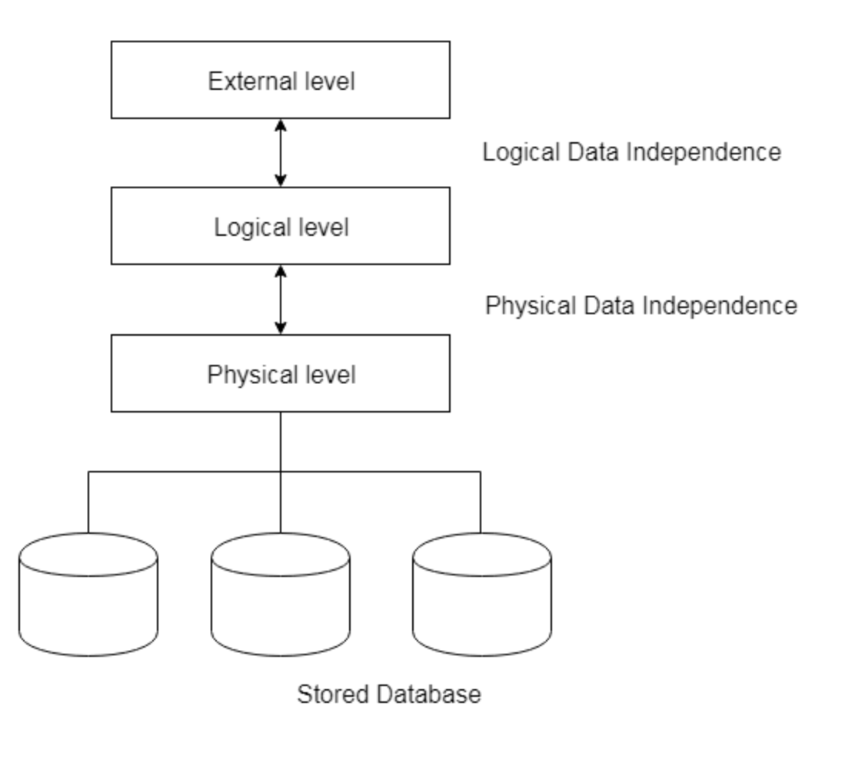
Data Independence : Physical Data Independence

Slide 25
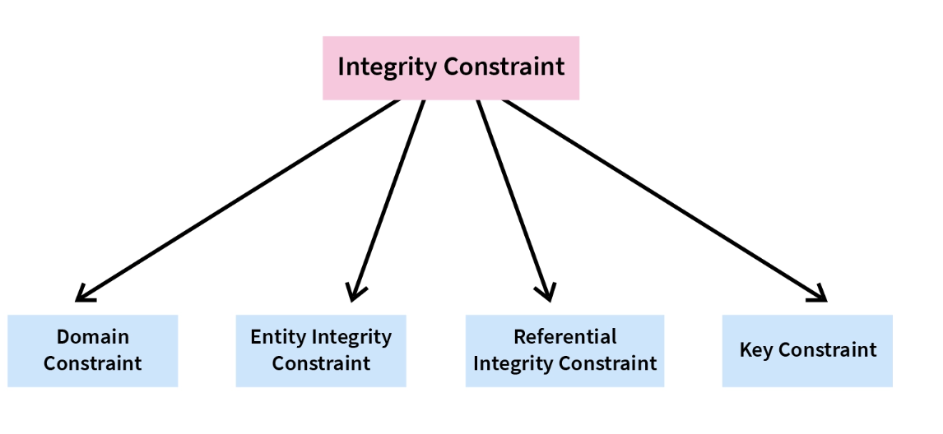
Integrity
Constraints

Slide 26
^{Integrity Constraints}
Integrity constraints are rules or conditions that are defined on a database schema to ensure the accuracy, consistency, and validity of data stored in a database.
These constraints enforce rules and restrictions on the data, preventing the entry of invalid or inconsistent values and maintaining data integrity.
Integrity constraints are typically specified during the database design phase and are enforced by the database management system (DBMS) during data manipulation operations.

Slide 27
Integrity Constraints : Domain Constraint
A domain constraint specifies the valid range of values for a column based on its data type. It restricts the values that can be stored in a column to ensure data integrity.
In this example, the "Grade" column is restricted by a domain constraint that allows only the values "A", "B", "C", "D", "E", or "F".
Any other value inserted or updated in the "Grade" column would violate the domain constraint and result in an error.
^{studentID} | ^{name} | ^{age} | ^{gender} | ^{grade}
¹ | ^{John} | ¹⁶ | ^{M} | ^{A}
² | ^{Jane} | ¹⁵ | ^{F} | ^{B}
³ | ^{Mark} | ¹⁷ | ^{M} | ^{C}

Slide 28
Integrity Constraints : Domain Constraint
The domain constraint ensures that the "Grade" column contains valid and appropriate values according to the defined domain.
It prevents the insertion of invalid or incorrect values that could compromise the integrity and meaning of the data.
By enforcing the domain constraint on the "Grade" column, the database management system guarantees that the stored data is consistent and aligned with the specified range of values.
^{studentID} | ^{name} | ^{age} | ^{gender} | ^{grade}
¹ | ^{John} | ¹⁶ | ^{M} | ^{A}
² | ^{Jane} | ¹⁵ | ^{F} | ^{B}
³ | ^{Mark} | ¹⁷ | ^{M} | ^{C}

Slide 29
Integrity Constraints : Entity Integrity Constraint
Entity integrity constraint, also known as entity key or entity uniqueness constraint, ensures that each row or entity in a table is uniquely identifiable by a primary key. .
It guarantees the uniqueness and non-nullity of the primary key values within a table.
^{studentID} | ^{name} | ^{Email} | ^{Phone}
¹ | ^{John} | ^{johndoe@example.com} | ¹²³⁻⁴⁵⁶⁻⁷⁸⁹⁰
² | ^{Jane} | ^{janesmith@example.com} | ⁹⁸⁷⁻⁶⁵⁴⁻³²¹⁰
³ | ^{Mark} | ^{markbrown@example.com} | ⁵⁵⁵⁻⁵⁵⁵⁻⁵⁵⁵⁵

Slide 30
Integrity Constraints : Entity Integrity Constraint
In this example, the "CustomerID" column serves as the primary key. Each row in the "Customers" table has a unique CustomerID value, ensuring that no two customers share the same identifier.
The entity integrity constraint guarantees the uniqueness and non-nullity of the primary key values, which is crucial for correctly identifying and distinguishing individual entities within the table

Slide 31
Integrity Constraints : Referential Integrity Constraint
Referential integrity constraint is a rule that ensures the consistency and validity of relationships between tables in a relational database.
It maintains the integrity of foreign key relationships, enforcing that values in a foreign key column correspond to valid primary key values in the referenced table.
^{OrderID} | ^{CustomerID} | ^{OrderDate} | ^{TotalAmount}
¹ | ¹ | ²⁰²³⁻⁰⁵⁻¹⁰ | ^{100.00}
² | ² | ²⁰²³⁻⁰⁵⁻¹² | ^{50.00}
³ | ¹ | ²⁰²³⁻⁰⁵⁻¹⁵ | ^{75.00}
^{CustomerID} | ^{Name} | ^{Email} | ^{Phone}
¹ | ^{John} | ^{johndoe@example.com} | ¹²³⁻⁴⁵⁶⁻⁷⁸⁹⁰
² | ^{Jane} | ^{janesmith@example.com} | ⁹⁸⁷⁻⁶⁵⁴⁻³²¹⁰

Slide 32
Integrity Constraints : Referential Integrity Constraint
In this example, the "CustomerID" column in the "Orders" table is a foreign key that references the primary key "CustomerID" in the "Customers" table.
The referential integrity constraint ensures that the values in the "CustomerID" column of the "Orders" table correspond to valid and existing values in the "CustomerID" column of the "Customers" table.
The referential integrity constraint prevents actions that would violate the integrity of the relationship, such as deleting a customer from the "Customers" table if there are corresponding orders in the "Orders" table.
By enforcing the referential integrity constraint, the database management system maintains the integrity of relationships between tables, supports accurate querying and joining of data, and helps prevent data inconsistencies and referential errors.

Slide 33
Integrity Constraints : Key Constraint
A key constraint, also known as a uniqueness constraint, ensures the uniqueness of values in one or more columns of a table.
It guarantees that the specified columns or combination of columns have distinct values for each row in the table.
Key constraints play a crucial role in maintaining data integrity and supporting data retrieval operations.
There are different types of key constraints:
^{Unique key}
^{Primary Key}

Slide 34
Integrity Constraints : Key Constraint
Unique Key Constraint: A unique key constraint ensures that the values in the specified column or combination of columns are unique across the table. Unlike primary keys, unique keys allow for null values, but they still enforce uniqueness.
It guarantees that no two rows in the table have the same values in the specified column(s).
^{EmployeeID} | ^{EmployeeCode} | ^{Name} | ^{Department}
¹ | ¹⁰⁰¹ | ^{John} | ^{Engineering}
² | ¹⁰⁰² | ^{Jane} | ^{Sales}
³ | ¹⁰⁰³ | ^{Mark} | ^{Marketing}

Slide 35
Key Constraints : Primary Key Constraint
A primary key constraint is a key constraint that uniquely identifies each row or entity in a table.
It guarantees the uniqueness and non-nullity of the specified column(s) and serves as the primary means of identifying and accessing rows in a table.
The primary key constraint plays a fundamental role in maintaining data integrity and supporting relational database operations.
^{EmployeeID} | ^{Name} | ^{Age} | ^{Grade}
¹ | ^{John} | ¹⁸ | ^{A}
² | ^{Jane} | ¹⁹ | ^{B}
³ | ^{Mark} | ²⁰ | ^{C}
In this example, the "StudentID" column is designated as the primary key for the "Students" table and guarantees that each student in the "Students" table has a unique "StudentID" value. No two students can have the same "StudentID".

Slide 36
Key Constraints : Primary Key Constraint
The primary key constraint provides several benefits:
Uniqueness: It ensures that each row in the table has a unique identifier, preventing the insertion of duplicate values in the primary key column(s).
Non-nullity: It enforces that the primary key column(s) cannot contain null values, ensuring that each row has a valid identifier.
Data integrity: By enforcing uniqueness and non-nullity, the primary key constraint helps maintain the integrity and reliability of data stored in the table.
Relationship establishment: The primary key constraint serves as a reference point for establishing relationships with other tables using foreign keys. It allows for the creation of meaningful relationships between tables, enabling data consistency and referential integrity.

Slide 37
Key Constraints : Composite Key Constraint
A composite key constraint, also known as a composite primary key, is a key constraint that involves a combination of two or more columns to uniquely identify each row or entity in a table.
This constraint ensures the uniqueness and non-nullity of the combined values in the specified columns.
^{ISBN} | ^{Title} | ^{Author} | ^{Year}
⁹⁷⁸⁻⁰⁰⁶¹¹²²⁴¹⁵ | ^{Mockingbird} | ^{Harper Lee} | ¹⁹⁶⁰
⁹⁷⁸⁻⁰¹⁴²⁴²⁴¹⁷⁹ | ¹⁹⁸⁴ | ^{George Orwell} | ¹⁹⁴⁹
⁹⁷⁸⁻⁰⁴⁵¹⁵²⁴⁹³⁵ | ^{Fahrenheit 451} | ^{Ray Bradbury} | ¹⁹⁵³
In this example, the combination of "ISBN" and "Year" is designated as the composite primary key for the "Books" table. Together, these two columns uniquely identify each book in the table.

Slide 38
Key Constraints : Composite Key Constraint
The composite key constraint provides several benefits:
Uniqueness: It ensures that the combination of specified columns has unique values for each row in the table, preventing the insertion of duplicate combinations.
Non-nullity: It enforces that the columns involved in the composite key cannot contain null values, ensuring that all components of the key are valid and present.
Complex identification: A composite key allows for the identification of rows based on multiple attributes or properties, capturing more nuanced and specific uniqueness requirements.
Relationship establishment: The composite key can be used as a reference in establishing relationships with other tables using foreign keys, enabling the establishment of meaningful and accurate relationships between related data.

Slide 39

^{Practice Questions}
Choose the correct statements regarding the advantages of data independence.
a) Data independence allows for easy migration from one DBMS to another.
b) Logical data independence makes it easier to modify the internal storage structures of the database.
c) Physical data independence ensures that application programs remain unaffected when the database schema is modified.
d) Data independence eliminates the need for security measures in the database.

